Slide 1
Boosting Prospecting with AI
Coach the AI, research faster, personalize every message
DEVELOPERS INSTITUTE

Slide 2
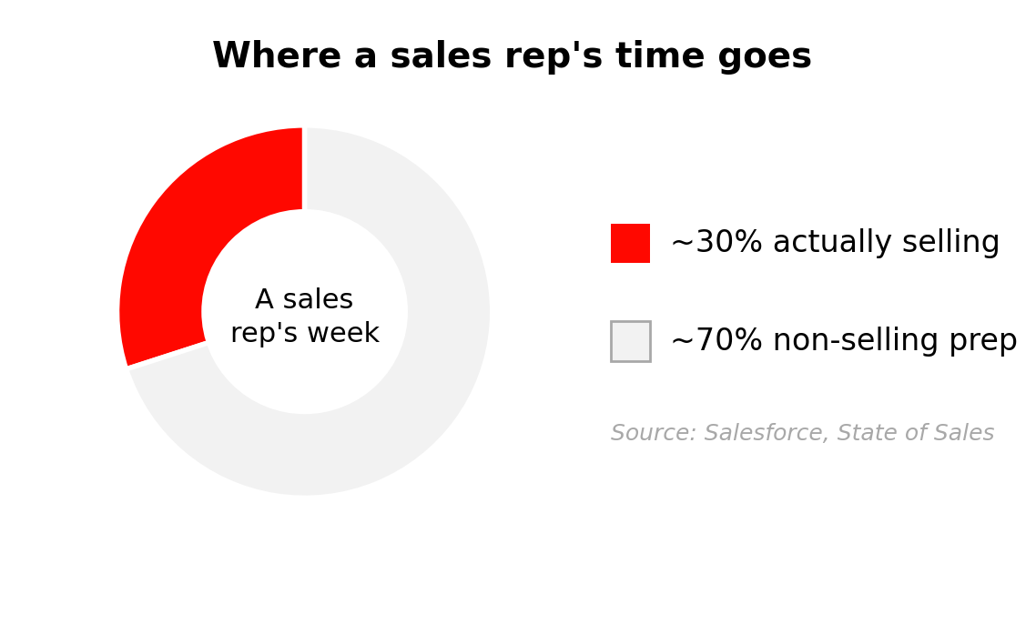
The problem AI actually solves
• Reps sell only ~30% of the week
• ~70% goes to non-selling prep
• Research, CRM, admin, bad data
• AI absorbs the prep — not the seller
DEVELOPERS INSTITUTE

Slide 3
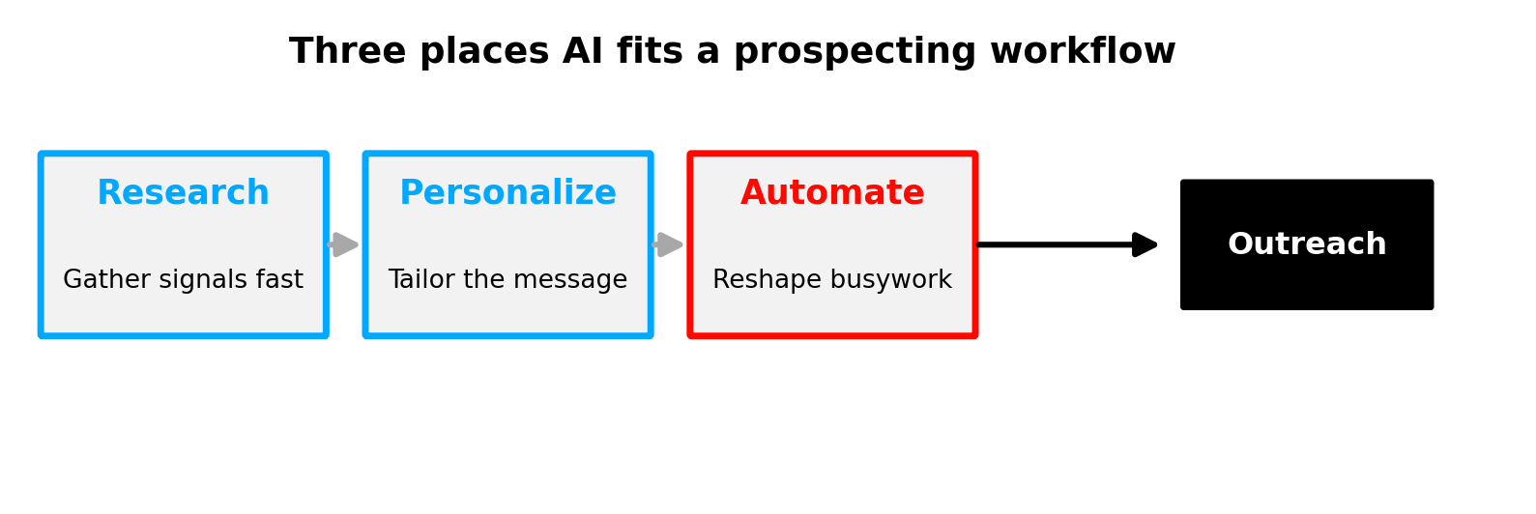
Where AI helps in prospecting
Research
Personalize
Automate
Gather signals fast
Tailor the message
Reshape the busywork
DEVELOPERS INSTITUTE

Slide 4
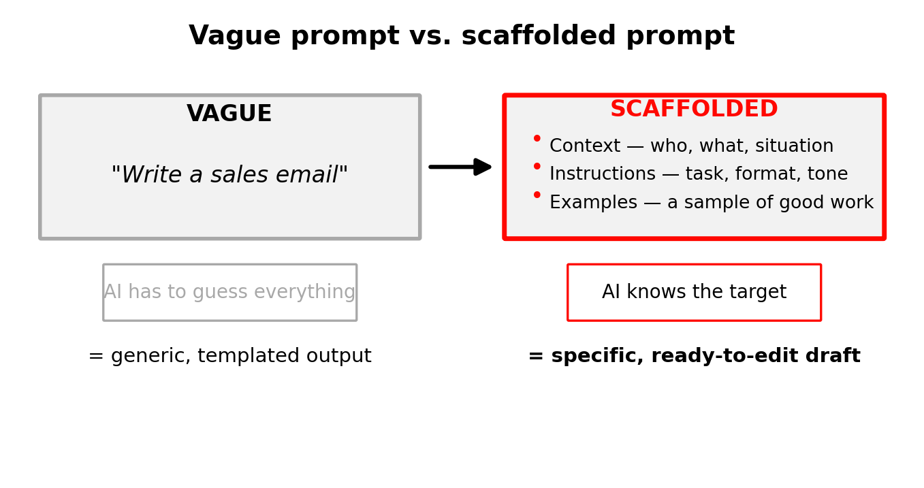
Vague prompt vs. scaffolded prompt
A scaffolded prompt replaces guesswork with context, instructions, and examples.
DEVELOPERS INSTITUTE

Slide 5
A reusable prompt recipe
Part
What to include
Role
Who the AI is helping
Context
Company, product, prospect
Task + format
What you want, how long
Example
A sample of good work
Constraint
"Don't invent facts"
The constraint line is the safety net — it keeps made-up claims out of your outreach.
DEVELOPERS INSTITUTE

Slide 6
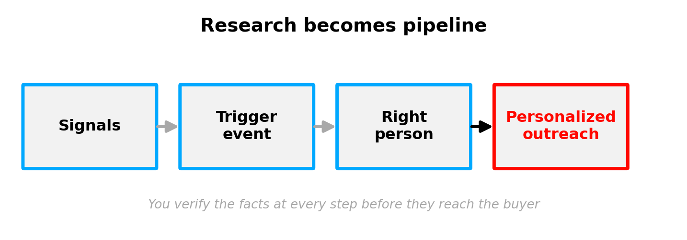
From research to outreach
You verify the facts at every step before they reach the buyer.
DEVELOPERS INSTITUTE

Slide 7
Trigger events: timing beats volume
15–25%
• Funding, hires, expansion = urgency
• First credible seller to act usually wins
reply rate for trigger-based outreach
vs. ~1–3% for generic cold
DEVELOPERS INSTITUTE

Slide 8
Tailor the message by persona
Persona
They care about
Lead with
CFO
Cost & risk
Money saved, payback
VP Sales / Ops
Pipeline, fewer fire drills
Speed, control
CTO / IT
Security, integration
Fits the stack
DEVELOPERS INSTITUTE

Slide 9
Key Takeaways
1
Reps lose ~70% of the week to non-selling work — AI wins it back.
2
Coach the AI: context + instructions + examples beats a vague ask.
3
Trigger events lift replies sharply; act fast.
4
Personalize per persona, and verify every fact before you send.
DEVELOPERS INSTITUTE

Slide 10
Questions?
DEVELOPERS INSTITUTE

